Slide 1
Trevo’s part
Use case, business usecase, demo, state of things

Slide 2
Motivation
“So What?”

Slide 3
Why Apache Beam?
We want to write our pipeline once.
Example ETL operations
Abstraction of a Pipeline:
Beyond simple cases- Apache Beam

Slide 4
Why Apache Beam?
We want to write our pipeline once.
Example ETL operations
Data sources change less frequently than engines
Do same simple procedures independent of backend
For this case consider different versions of same engine- API breaking changes, etc.
Counter point: Apache NiFi and runners
Abstraction of a Pipeline:
Beyond simple cases- Apache Beam

Slide 5
Why Apache Beam?
We want to write our pipeline once.
Example ETL operations
Abstraction of a Pipeline:
Recurring theme:
Apache Mahout
Apache NiFi
Etc.
Beyond simple cases- Apache Beam

Slide 6
Why Apache Beam?
We want to write our pipeline once.
Example ETL operations
Abstraction of a Pipeline:
Beyond simple cases- Apache Beam
Allows quicker ‘custom’ transformations.
NiFi vs. Beam→ Ease of use vs. Flexability
Machine Learning on Beam
Not a thing yet- but a possible direction of the industry
Lot’s of wasted code rewriting SGD/K-Means/ALS for every engine
Apache Mahout similar (Multiple backends, common language for front end)
Talk of adding Apache Beam as runner for Mahout once API settles down

Slide 7
Theoretical Business Case
I have an ETL process:
I load log files format consistent for last 10 years
I want to:
Load the log files
Join each log with an existing table: [customers, product info, store info, …]
Some of these table are joined together, enrichment continues for 4 levels
Results are aggregated end of day
When real time data reception becomes cost effective I will want the same format but in real time
Pain points:
Already migrated back end twice in last 10 years (Mainframe, Netezza, Spark)
Spark API breaking version changes, e.g 1.3-> 1.4, 1.6-> 2.0
May move to another system when real-time streaming
May not move entirely- e.g. some jobs will still be batch, hybrid Spark/Flink env

Slide 8
”Demo”
http://chi-flink-zeppelin.mybluemix.net/#/notebook/2BXPJDUFK
https://github.com/chi-apache-flink-meetup/beam_and_flink_meetup_2016_10_18
(git repo contains notebook)

Slide 9
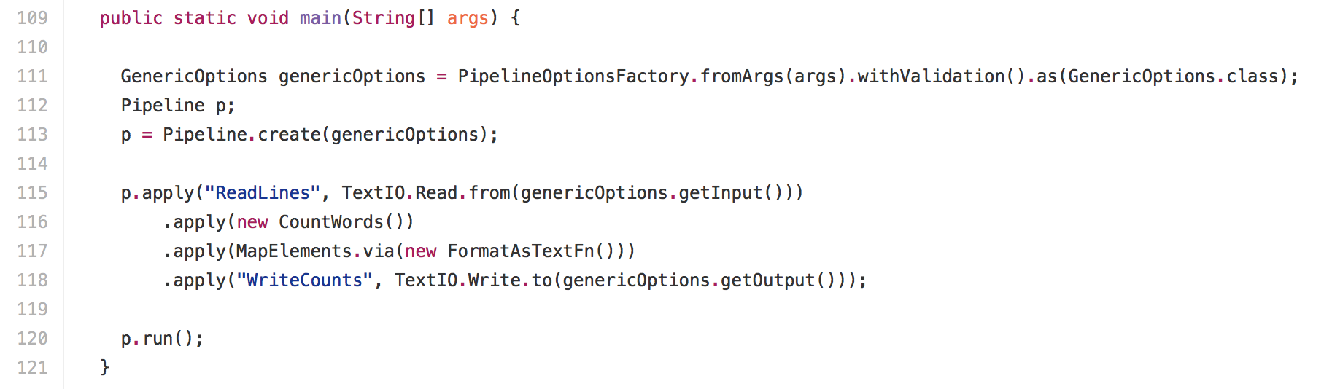
Consistent Pipeline Code
Word Count
Runs on Spark or Flink AS-IS*

Slide 10
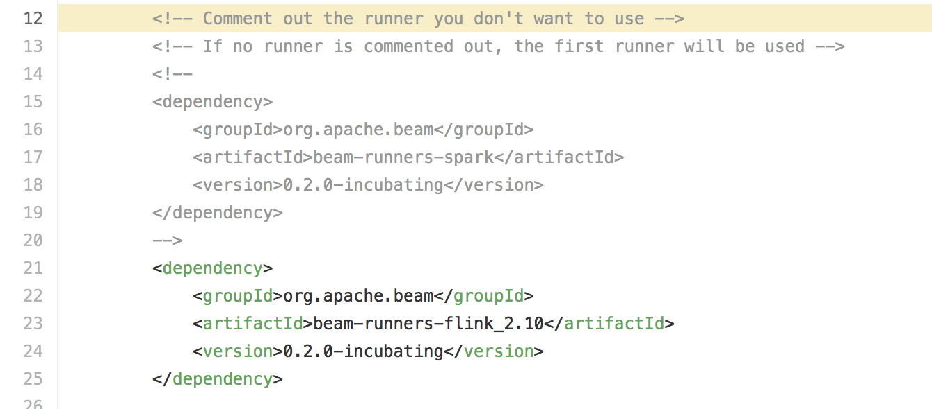
As-is*
Small Change in .pom for specified runner.
Shouldn’t be this way- regression as part of migration from 0.2-> 0.3

Slide 11
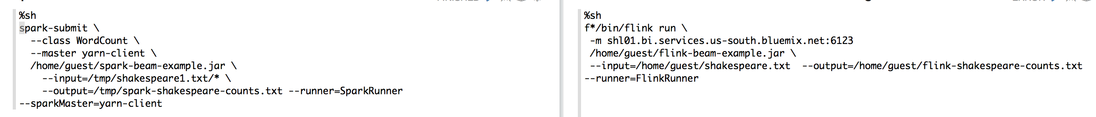
CLI Execution
Spark
Flink

Slide 12
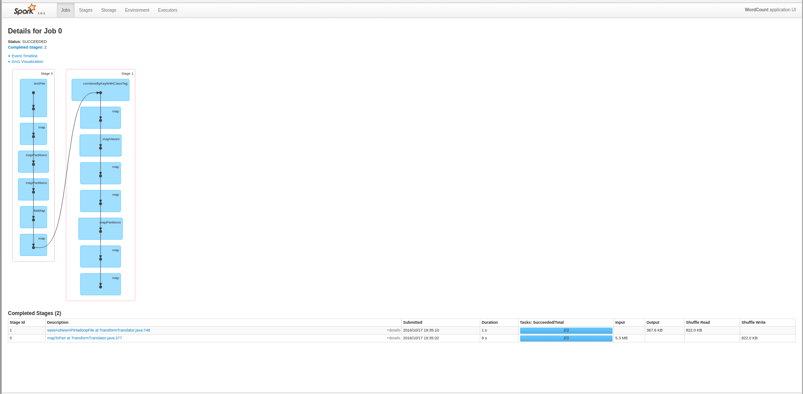
Spark DAG

Slide 13
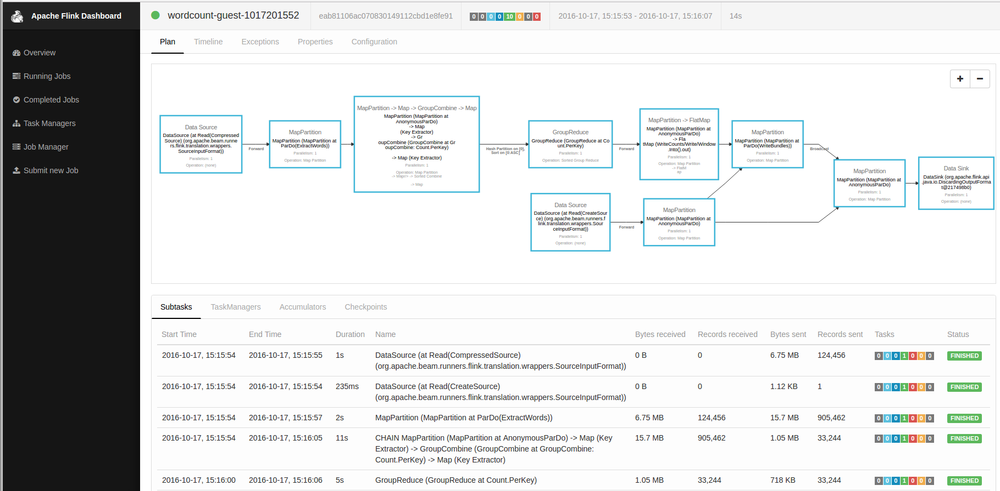
Flink DAG

Slide 14
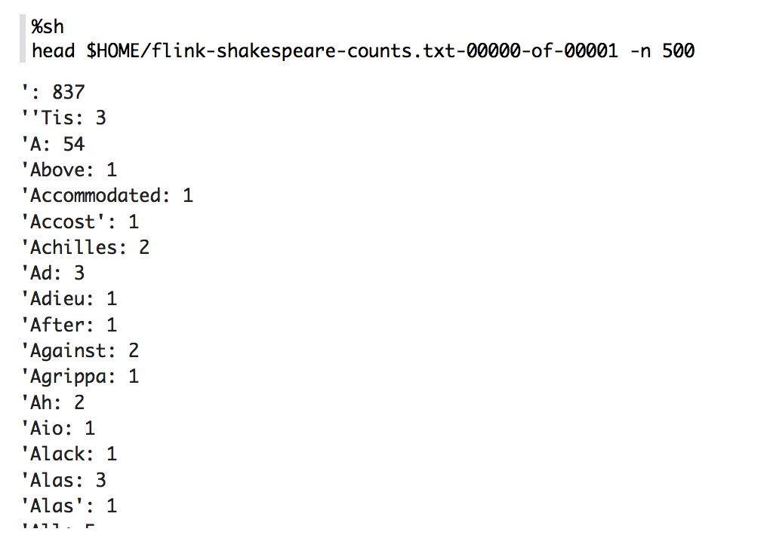
Raw Output

Slide 15
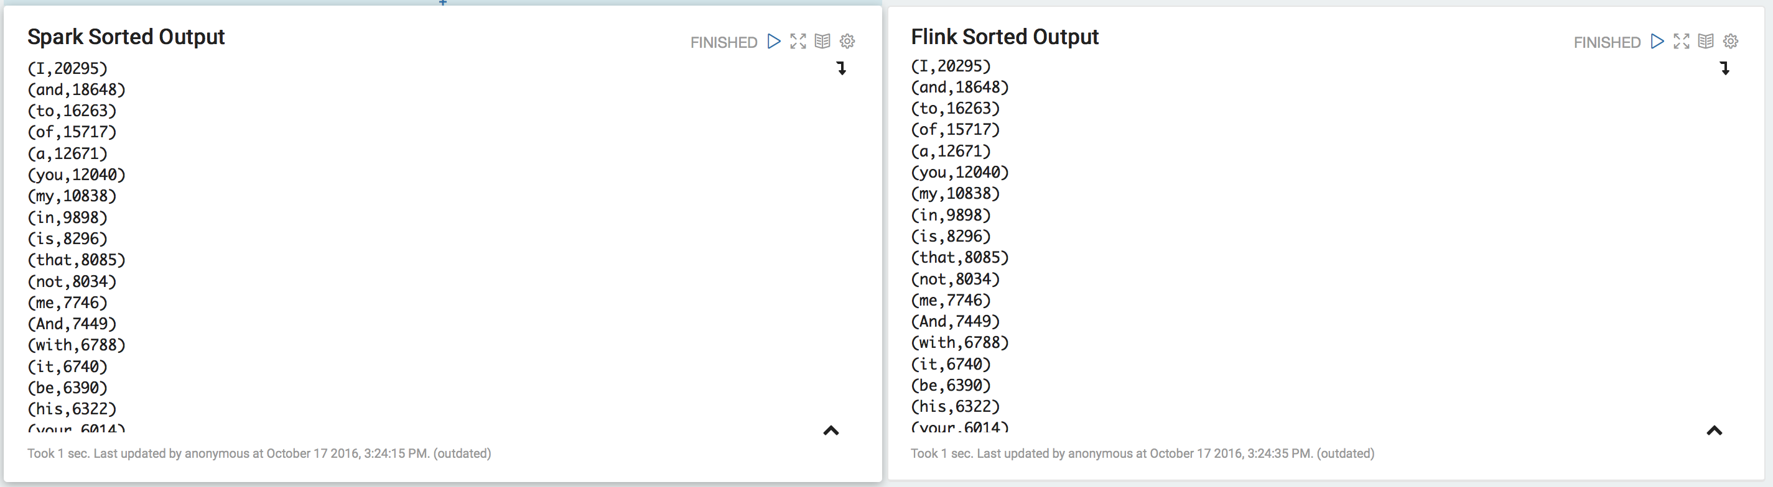
Outputs
CONSISTENT!

Slide 16
Current State of Things (Cold Water)
IMHO: Beam is interesting, but has a way to go
Only can stream-write into Google Cloud atm.
Regression prevented streaming to Text File / HDFS / etc.
V0.2-incubator implies still a work in progress
Verdict:
Beam is driving the conversation of the concept of a unifying API.
Beam has lots of great material on theoretical streaming, much of though behind Flink is based on Google’s DataFlow paper, which is a good read.
Beam has a way to go before being production ready
E.g. don’t go home and try to put Beam into production- you’ll be sorry.
DO keep an eye on Beam and watch it’s development
Flink hopes to be primary runner for Beam- runner of choice.
Best Viable open source candidate at the moment.

Slide 17
Admin
“The ‘ayes’ have it”

Slide 18
Agenda
Next Meetup Topic?
Kim is thinking about starting a local chapter of “Women in Big Data”
Anyone interested, happy to work with you to help generate content
Larger theme: “People are getting Meetup’d out”
Thoughts?
Considering moving to policy aggressive pursuit of joint meetups
When applicable, e.g. not diluting quality of this meetup
I’m speaking at CHUG next month
Creating hybrid distributed/native computation environment with Apache Mahout
Flink handles shipping data around, dumped out of JVM to local CPUs/GPUs when reasonable
Other Items

Slide 19
A note on our ‘environment’
I can leave:
http://chi-flink-zeppelin.mybluemix.net
http://chi-flink-flink.mybluemix.net
Up, They will expire every 14 days- hit me up if you’d like to play and the sites are down.
Better solution:
Sign up for BlueMix / Big Insights
Latest blog post tells how: https://trevorgrant.org/2016/10/13/deep-magic-volume2-absurdly-large-ols-with-apache-mahout/
Also on blog: Twitter and Gelly (with d3js visualizations) walk throughs

